Slide 1

Ecommerce Women’s Clothing Review
Data Science
And
Machine Learning
2018 Fall
104403044吳謦廷
104403011范哲豪

Slide 2




Tasks of the Study
Sentiment Analysis
Product Ratings Prediction

Slide 3
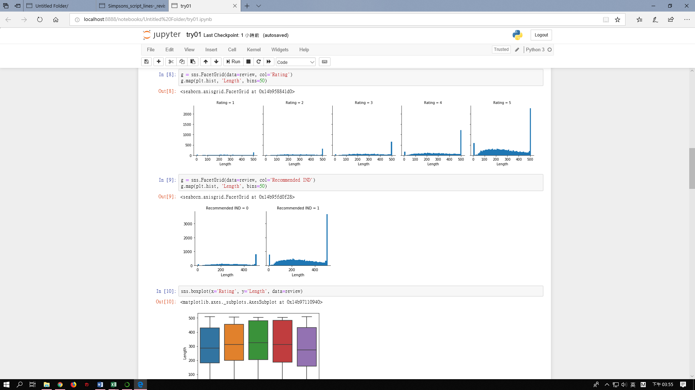
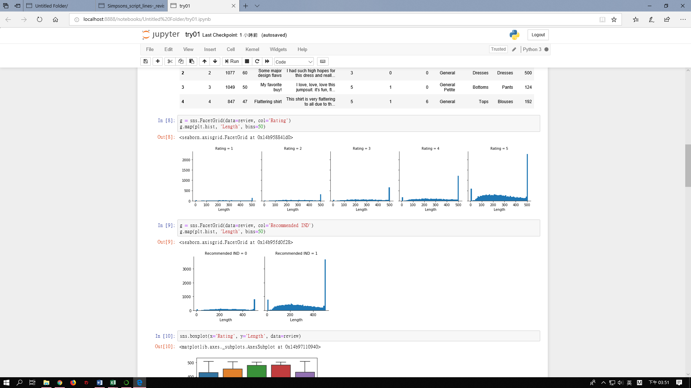
Description of Dataset
Length of Review Text

Slide 4
Description of Dataset
Rating | Numbers of instances | Percentage
1 | 842 | 0.04
2 | 1565 | 0.07
3 | 2871 | 0.12
4 | 5077 | 0.21
5 | 13491 | 0.56
Imbalanced dataset → oversampling, feature selection …

Slide 5

Pre-processing
Lower case adjustment
Remove punctuations
Tokenize
Stemming
Vectorizing
TF-IDF

Slide 6
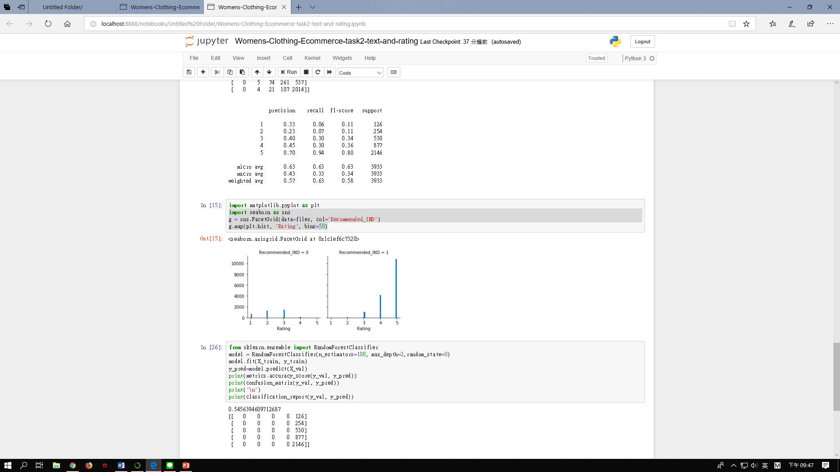
Neutral Reviews
What are we going to do with Neutral Reviews??

Slide 7
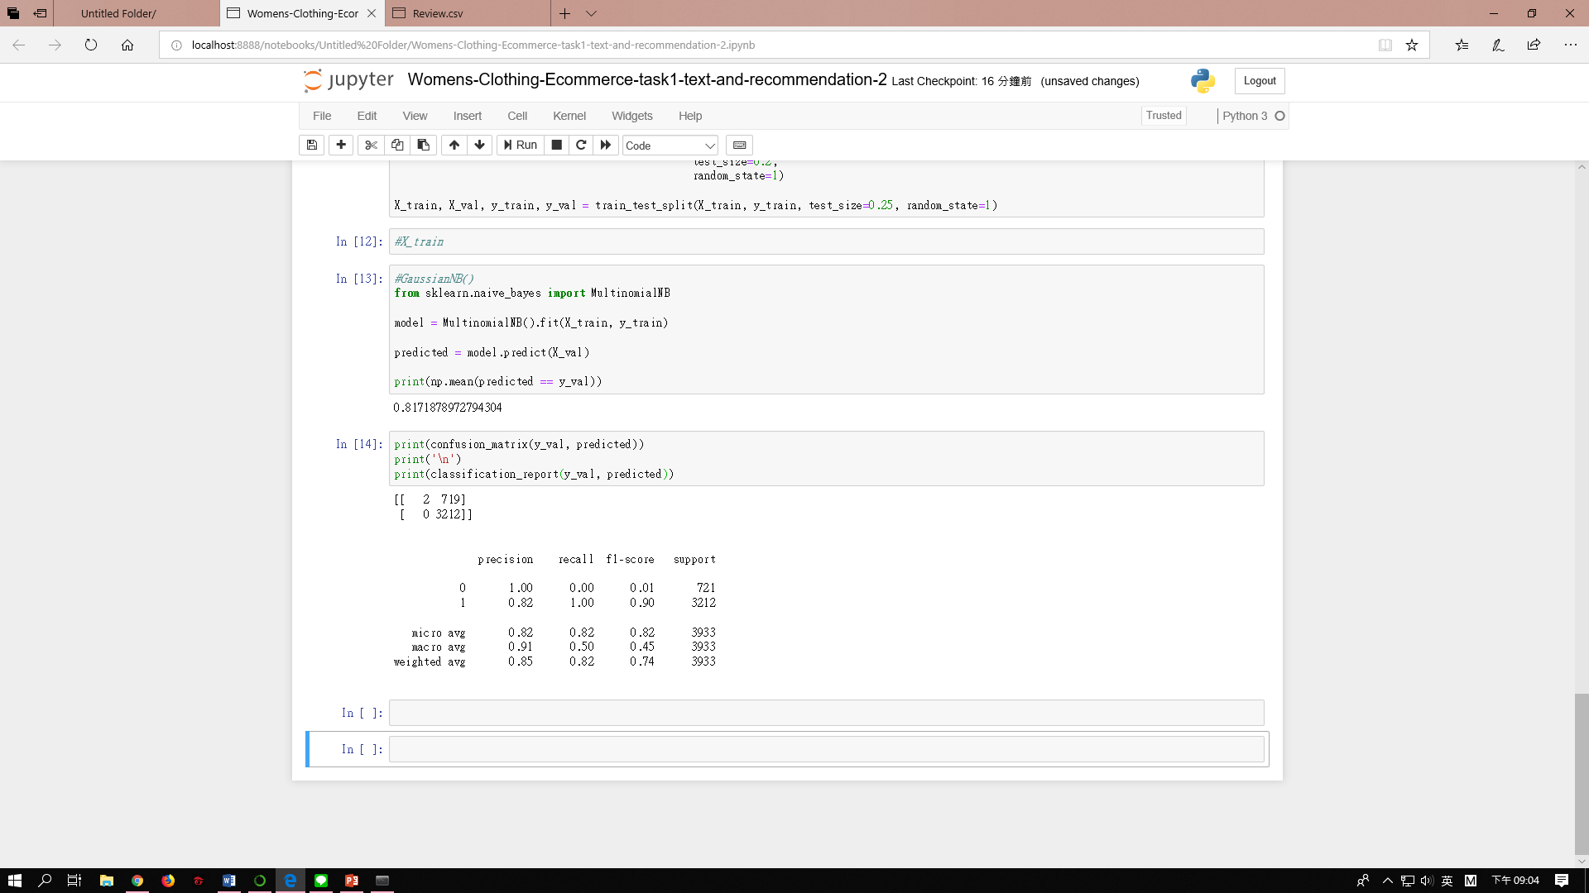
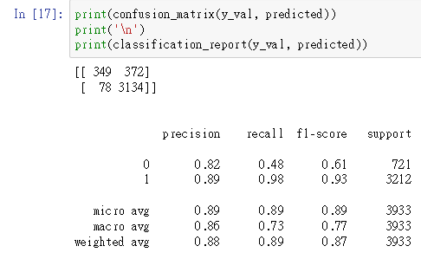
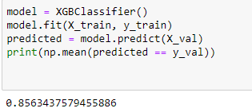
Sentimental Analysis
Results
Naïve Bayes 0.82
Logistic Regression 0.89
XGBoost 0.85

Slide 8
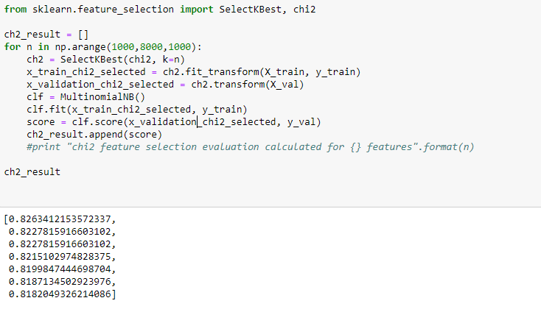
Sentimental Analysis
Feature Selection
Naïve Bayes 0.817
Chi-Square 0.826

Slide 9
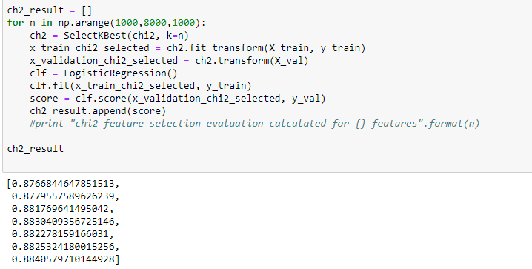
Sentimental Analysis
Feature Selection
Logistic Regression 0.885
Chi-Square 0.876

Slide 10
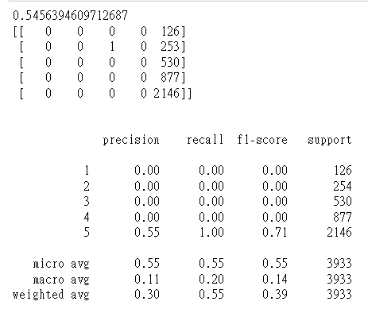
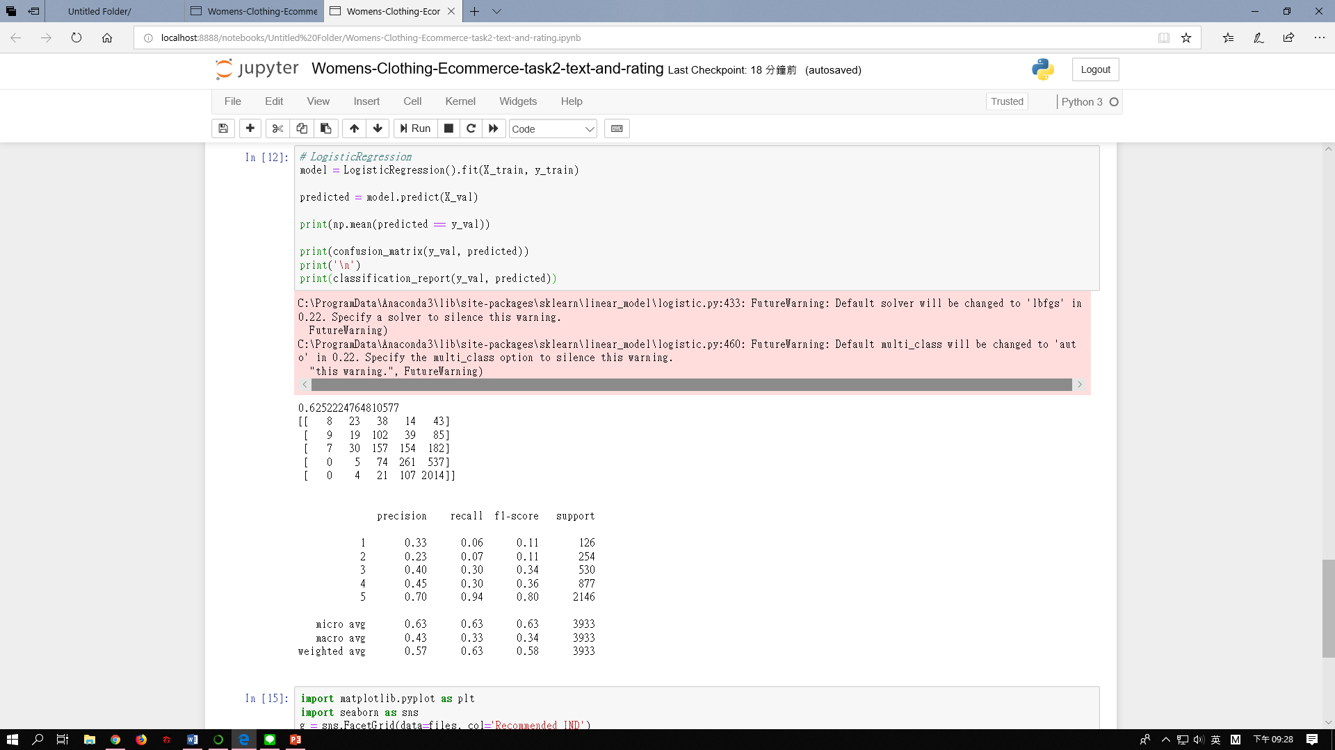
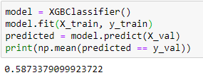
Product Ratings Prediction
Results
Naïve Bayes 0.55
Logistic Regression 0.63
XGBoost 0.59

Slide 11
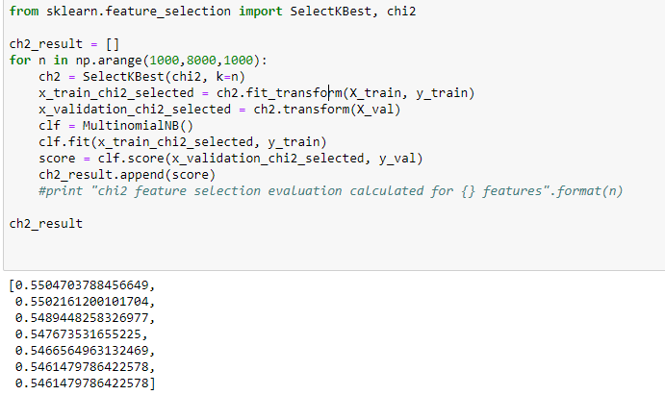
Product Ratings Prediction
Feature Selection
Naïve Bayes 0.545
Chi-Square 0.550

Slide 12
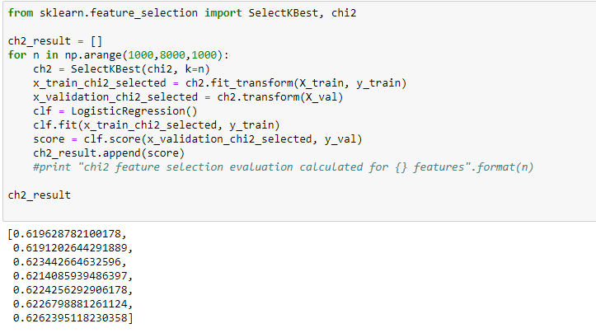
Product Ratings Prediction
Feature Selection
Logistic Regression 0.625
Chi-Square 0.619

Slide 13
Reference
Jeevanandam Jotheeswaran and Dr. S. Koteeswaran, “Sentiment Analysis: A Survey of Current Research and Techniques.”
Guo, Lu, and Wang, “Predicting Restaurants’ Rating And Popularity Based On Yelp Dataset.”
Martin, “Predicting Ratings of Amazon Reviews - Techniques for Imbalanced Datasets.”
Agarwal et al., “Sentiment Analysis of Twitter Data.”

Slide 14
Thank you for your listening.
Data Science
And
Machine Learning
2018 Fall

